Slide 1
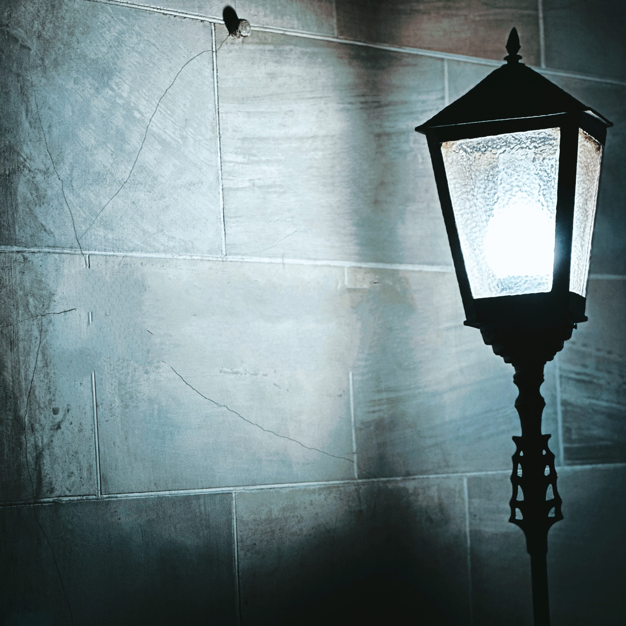
A JP Luce Experience
Deathday
Shot with Samsung Galaxy S23 Ultra
Written and Directed by JP Luce

Slide 2
Cast Joseph Cutler Nisha Simone Joe Zedd * Seeni Chandran Michelle Renee Johnson Allie Nelson Nekko Ortiz Chico Samuel Davlat Tagiev * Blake Grossman Rhoc Kwawununu Pryce Taylor Lameek Vanderveer Shameek Vanderveer Production Company l.n. Ortiz, LLC Executive Producer/Director/Writer/ Casting/Photography JP Luce Music l.n. Ortiz, LLC Associate Producer Brian E. Payne Editor L.N. Ortiz, LLC | Script Supervisor Donna N. Downes On-set Stills Photographer Patrice Payne Narrator Simone Suber Special Thanks To Brooklyn Navy Yard Development Corporation Most Holy Trinity St. Mary Church Pexels New York City Department of Parks & Recreation AND Simone Robinson Barnett Ricardo Bowens Janyce Hunt Emilio Llopiz Al Payne Friar Richard Riccioli Gyvis Santos Felix Torres Chistopher Williams

